Slide 1
Addressing Modes
The operation field of an instruction specifies the operation to be performed. This operation must be executed on some data stored in computer registers or memory words. The way the operands are chosen during program execution is dependent on the addressing mode of the instruction.
The addressing mode specifies a rule for interpreting or modifying the address field of the instruction before the operand is actually referenced. Computers use addressing mode techniques for the purpose of accommodating one or both of the following provisions:
To give programming versatility to the user by providing such facilities as pointers to memory, counters for loop control, indexing of data, and program relocation.
To reduce the number of bits in the addressing field of the instruction.

Slide 2
The availability of the addressing modes gives the experienced assembly language programmer flexibility for writing programs that are more efficient with respect to the number of instructions and execution time. To understand the various addressing modes to be presented in this section, it is imperative that we understand the basic operation cycle of the computer.
The control unit of a computer is designed to go through an instruction cycle that is divided into three major phases:
1. Fetch the instruction from memory.
2. Decode the instruction.
3. Execute the instruction.

Slide 3

An example of an instruction format with a distinct addressing mode field is shown in Fig. below. The operation code specifies the operation to be performed. The mode field is used to locate the operands needed for the operation. There may or may not be an address field in the instruction. If there is an address field, it may designate a memory address or a processor register. Moreover, as discussed in the preceding section, the instruction may have more than one address field, and each address field may be associated with its own particular addressing mode. Although most addressing modes modify the address field of the instruction, there are two modes that need no address field at all.
These are the implied and immediate modes.

Slide 4
Various Addressing Modes are:
Implied Mode
Immediate Mode
Register Mode
Register Indirect Mode
Autoincrement or Autodecrement Mode
Direct Address Mode
Indirect Address Mode
Relative Address Mode

Slide 5

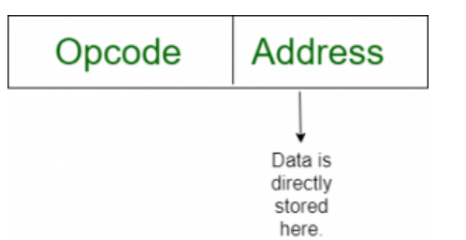
Implied Mode: In this mode the operands are specified implicitly in the definition of the instruction. For example, the instruction "complement accumulator" is an implied-mode instruction because the operand in the accumulator register is implied in the definition of the instruction. In fact, all register reference instructions that use an accumulator are implied-mode instructions. Zero-address instructions in a stack-organized computer are implied-mode instructions since the operands are implied to be on top of the stack.(CMA)
Immediate Mode: In this mode the operand is specified in the instruction itself. In other words, an immediate-mode instruction has an operand field rather than an address field. The operand field contains the actual operand to be used in conjunction with the operation specified in the instruction. Immediate-mode instructions are useful for initializing registers to a constant value.

Slide 6
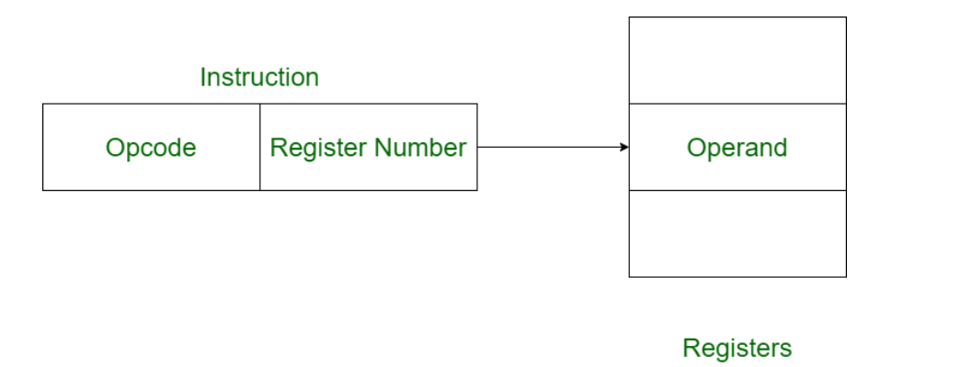

Register Mode: In this mode the operands are in registers that reside within the CPU. The particular register is selected from a register field in the instruction.
Register Indirect Mode: In this mode the instruction specifies a register in the CPU whose contents give the address of the operand in memory. In other words, the selected register contains the address of the operand rather than the operand itself. Before using a register indirect mode instruction, the programmer must ensure that the memory address of the operand is placed in the processor register with a previous instruction.

Slide 7
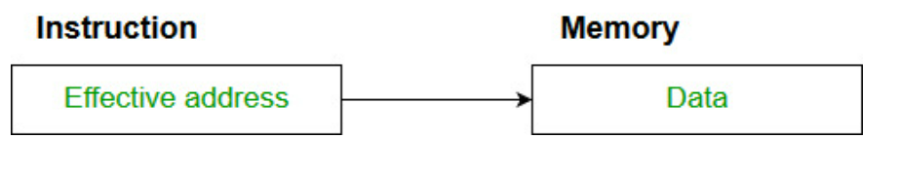
Autoincrement or Autodecrement Mode: This is similar to the register indirect mode except that the register is incremented or decremented after (or before) its value is used to access memory. When the address stored in the register refers to a table of data in memory, it is necessary to increment or decrement the register after every access to the table. This can be achieved by using the increment or decrement instruction. However, because it is such a common requirement, some computers incorporate a special mode that automatically increments or decrements the content of the register after data access.
Direct Address Mode: In this mode the effective address is equal to the address part of the instruction. The operand resides in memory and its address is given directly by the address field of the instruction. In a branch-type instruction the address field specifies the actual branch address.

Slide 8
Indirect Address Mode: In this mode the address field of the instruction gives the address where the effective address is stored in memory. Control fetches the instruction from memory and uses its address part to access memory again to read the effective address. A few addressing modes require that the address field of the instruction be added to the content of a specific register in the CPU. The effective address in these modes is obtained from the following computation: effective address = address part of instruction + content of CPU register.
Relative Address Mode: In this mode the content of the program counter is added to the address part of the instruction in order to obtain the effective address. The address part of the instruction is usually a signed number (in 2' s complement representation) which can be either positive or negative. When this number is added to the content of the program counter, the result produces an effective address whose position in memory is relative to the address of the next instruction.

